Slide 1
Learner Portfolio Check In
GO!

Slide 2
Table of Contents
Past
Present
Future
Credits

Slide 3
01
Personal Growth
01
Table of contents
02
03

Slide 4
Literature Pieces
01
Table of contents
02
03
Neruda
Lispector
Love
Nature
Patriotism
Existentialism
Strained Relationship
Orwell
Yu Hua
Straightforward
Few words to convey message
Motifs
Text to Self Connections

Slide 5
02
The Present
01
Table of contents
02
03

Slide 6
Poetry
Neruda
Dickinson
01
Table of contents
02
03
Focused on breadth instead of depth
Narrowed the focus down to one style and one form element

Slide 7
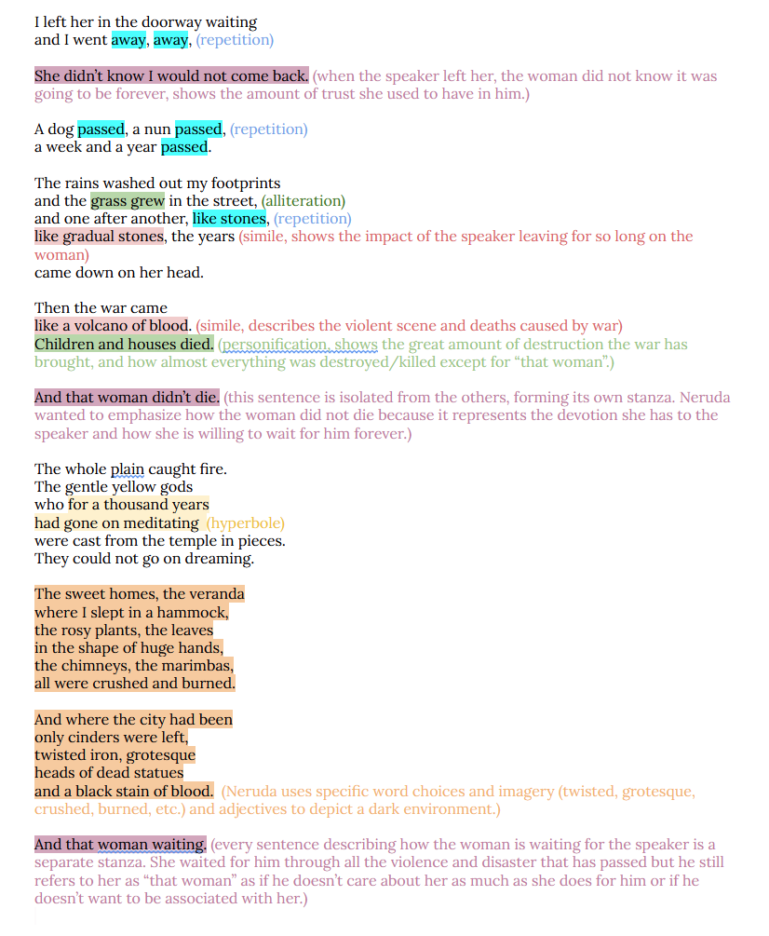
01
Table of contents
02
03

Slide 8
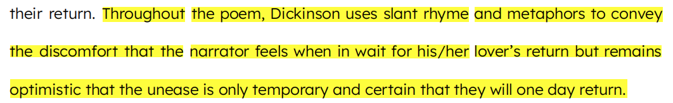
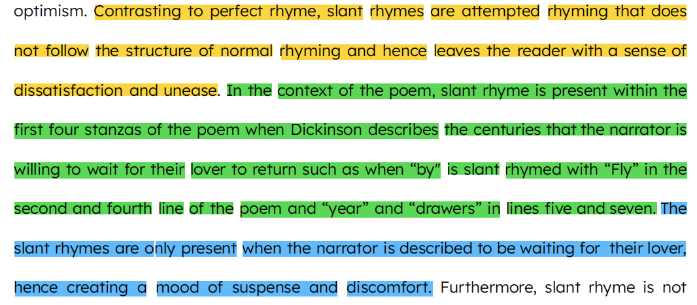
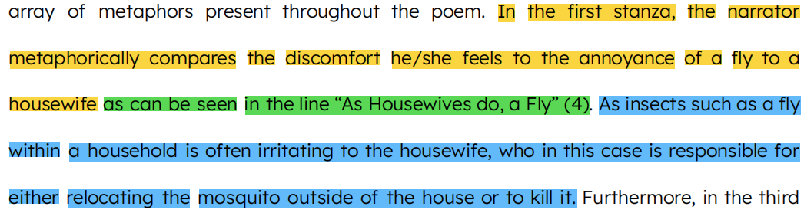
Poem 511 Analysis
01
Table of contents
02
03

Slide 9
Practice Makes Perfect
01
Table of contents
02
03

Slide 10
03
The
Future
01
Table of contents
02
03

Slide 11

MAUS
A survivor’s Tale
01
Table of contents
02
03

Slide 12
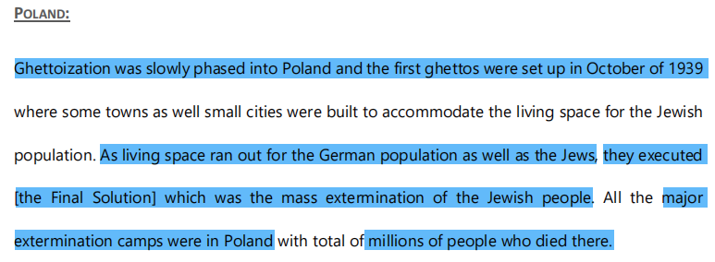
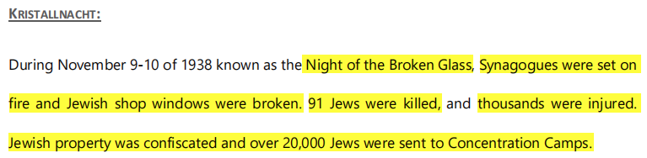
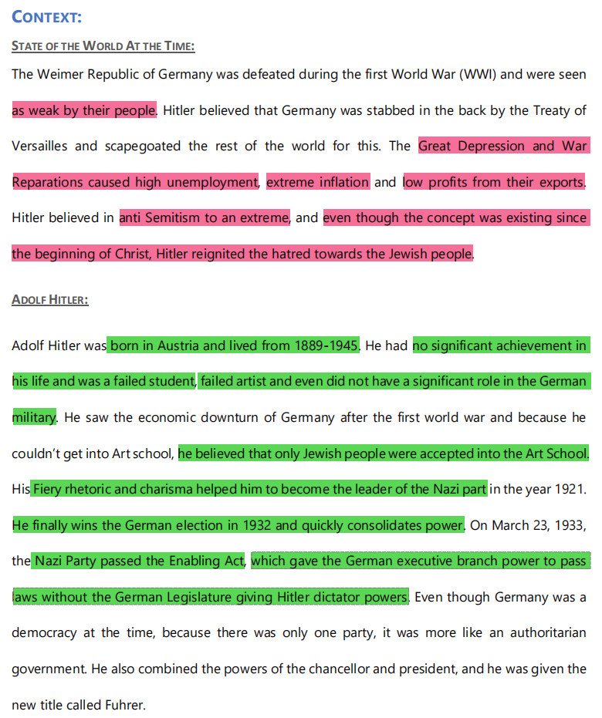
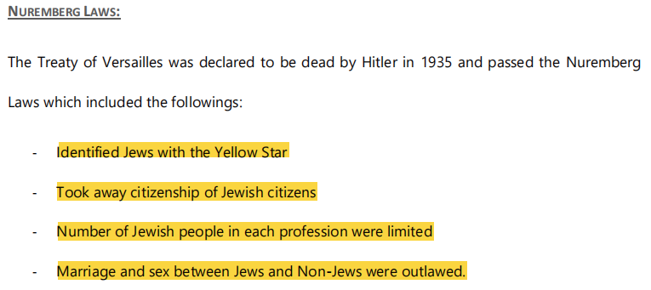
Historical Context
01
Table of contents
02
03

Slide 13
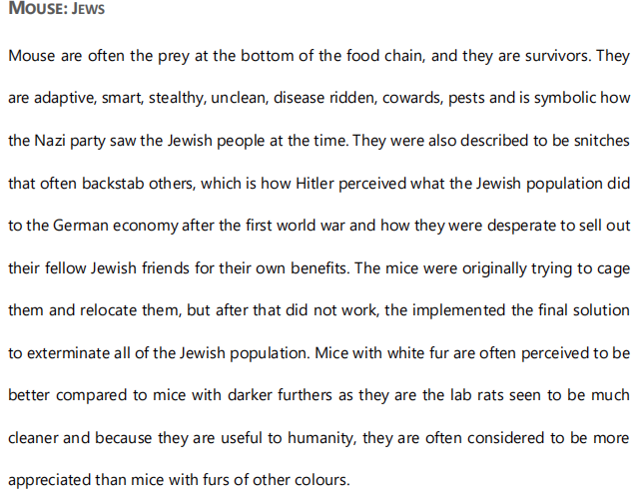
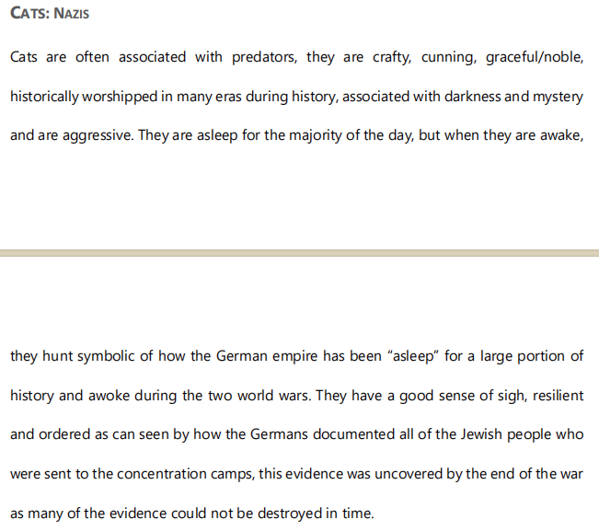
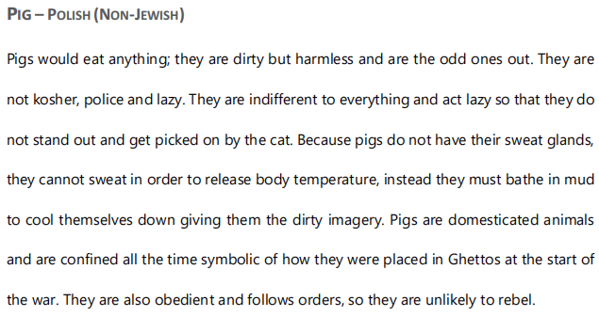
01
Table of contents
02
03

Slide 14
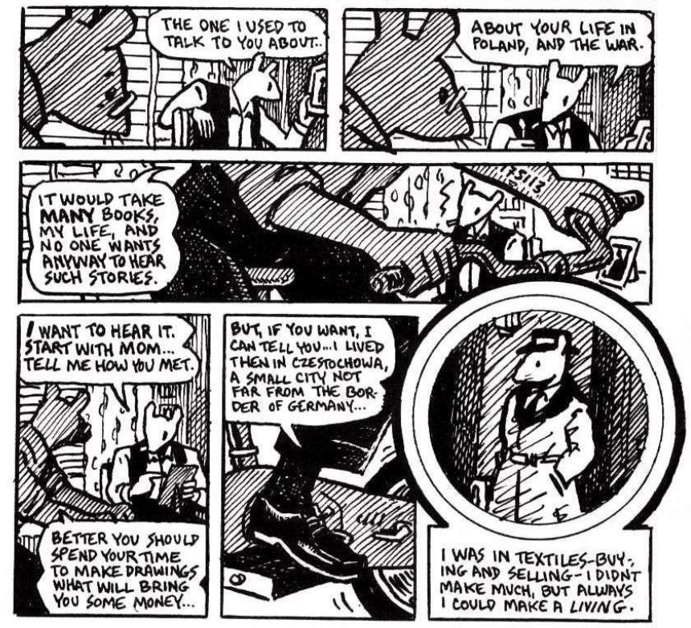
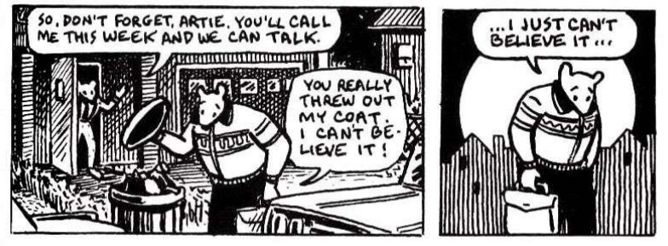
Generational Trauma
01
Table of contents
02
03

Slide 15

Half a Lifelong
Romance
01
Table of contents
02
03

Slide 16
Belief
Value
Education
01
Table of contents
02
03

Slide 17
Thank You
01
Table of contents
02
03

